Slide 1
Cross-Validation & Generalization
k-Fold CV | Bias-Variance Trade-off | Model Selection via CV Scores

Slide 2
What is Generalization?
Ability of a model to perform well on unseen data (not just training data).
Goal: Minimize error on new, unseen data.
Overfitting: Model memorizes training data → poor generalization.
Underfitting: Model too simple → poor training and test performance.

Slide 3
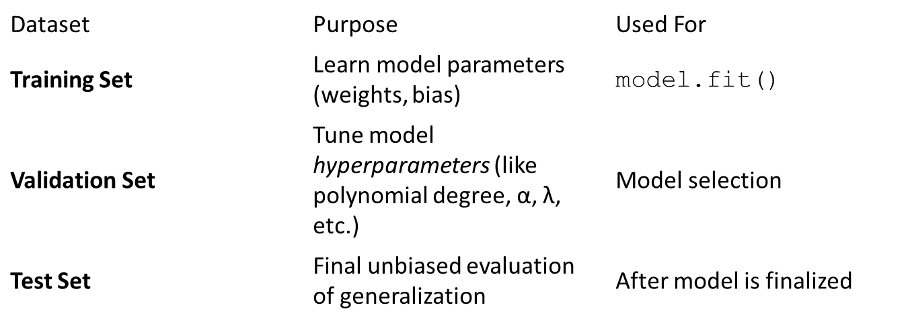
Measuring Generalization
Split data into Training, Validation, and Test sets.
Single split may depend too much on random data division → unstable results.

Slide 4
Holdout Validation
In Holdout Validation method typically does
Training: 60–70%
Validation: 15–20%
Test: 15–20%
Making it simple and quick to apply.
When you split data into three parts, only a fraction (say 60–70%) is used for training.
The remaining 30–40% (validation + test) is held out and not used for fitting model parameters.
On small or moderate datasets, this means the model trains on less data than it could leading to:
higher variance in performance estimates, weaker models, and less stable results.
With a single fixed split, results depend heavily on how the data was divided.
A lucky or unlucky split can make a model look better or worse.
Different random splits can produce quite different validation/test scores, especially when the dataset is small or has outliers.

Slide 5
How to judge overfitting and underfitting
Underfitting (High bias): both training and validation error are high.
Good fit: training error ↓, validation error ↓.
Overfitting (High variance): training error ↓ further, but validation error ↑.

Slide 6
Cross-Validation (CV)
It is a technique used to check how well a machine learning model performs on unseen data while preventing overfitting.
It works by:
Splitting the dataset into several parts.
Training the model on some parts and testing it on the remaining part.
Repeating this resampling process multiple times by choosing different parts of the dataset.
Averaging the results from each validation step to get the final performance.

Slide 7
1. LOOCV (Leave One Out Cross Validation)
Model is trained on the entire dataset except for one data point which is used for testing.
This process is repeated for each data point in the dataset.
All data points are used for training, resulting in low bias.
Testing on a single data point can cause high variance, especially if the point is an outlier.
It can be very time-consuming for large datasets as it requires one iteration per data point.

Slide 8
2. K-Fold Cross Validation
K-Fold Cross Validation splits the dataset into k equal-sized folds. The model is trained on k-1 folds and tested on the remaining fold. This process is repeated k times each time using a different fold for testing.

Slide 9
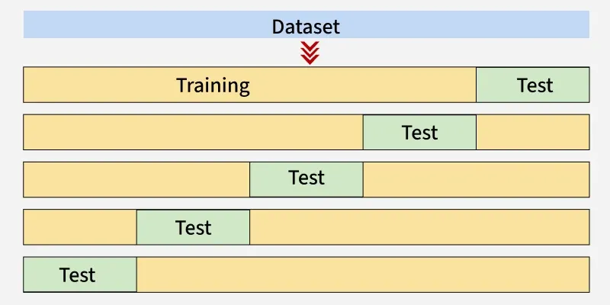
Example of K-Fold Cross Validation
Here we will take k as 5.
1st iteration: The first 20% of data [1–5] is used for testing and the remaining 80% [6–25] is used for training.
2nd iteration: The second 20% [6–10] is used for testing and the remaining data [1–5] and [11–25] is used for training.
This process continues until each fold has been used once as the test set.

Slide 10
Iteration | Training Set Observations | Testing Set Observations
1 | [5-24] | [0-4]
2 | [0-4, 10-24] | [5-9]
3 | [0-9, 15-24] | [10-14]
4 | [0-14, 20-24] | [15-19]
5 | [0-19] | [20-24]
Each iteration uses different subsets for testing and training, ensuring that all data points are used for both training and testing.

Slide 11
3. Stratified Cross-Validation (used for classification problems only)
It is a technique that ensures each fold of the cross-validation process has the same class distribution as the full dataset.
This is useful for imbalanced datasets where some classes are underrepresented.
The dataset is divided into k folds, keeping class proportions consistent in each fold.
In each iteration, one fold is used for testing and the remaining folds for training.
This process is repeated k times so that each fold is used once as the test set.
It helps classification models generalize better by maintaining balanced class representation.

Slide 12
Bias-Variance Trade-off
Bias: Error due to simplifying assumptions; leads to underfitting.
Variance: Error due to model sensitivity to training data; leads to overfitting.
Goal: Balance both to minimize total error.
Visualization: U-shaped curve (x-axis: model complexity, y-axis: error).

Slide 13
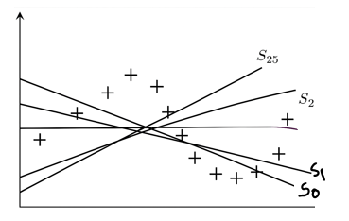
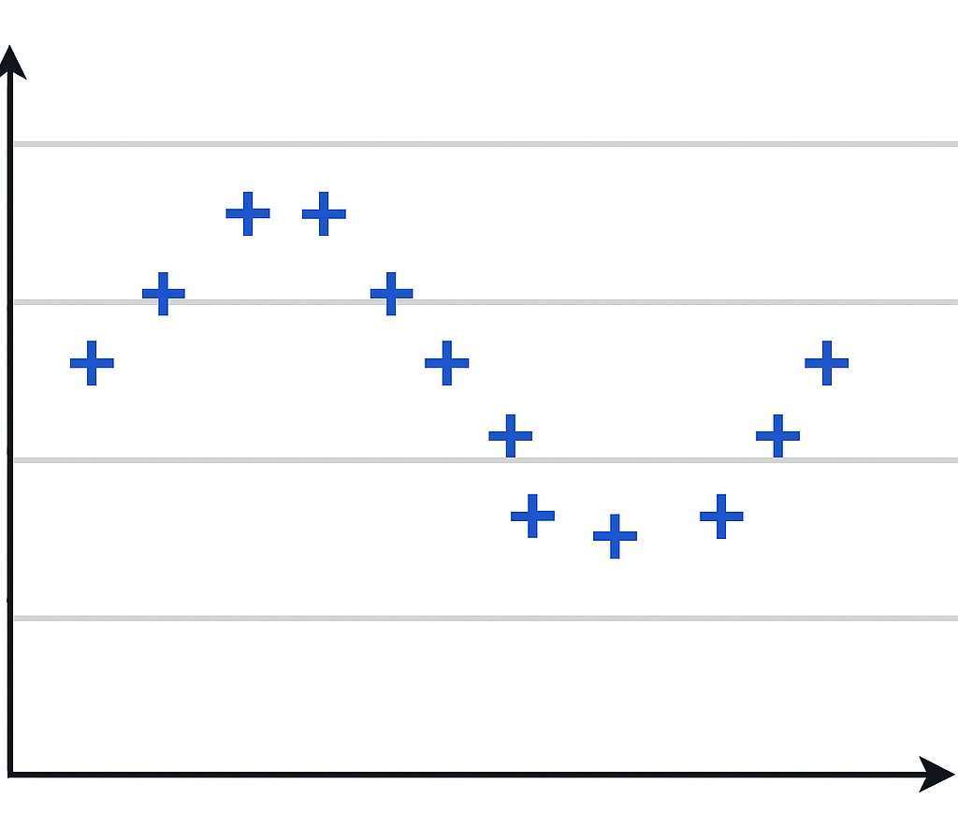

Bias Variance Trade-off
Let us consider the problem of fitting a curve through a given set of points.
We consider two models –
a) Simple model of degree 1.
ŷ = h(x) = ω₀​+ω₁​x
Randomly drawn dataset of 100 instances

Slide 14
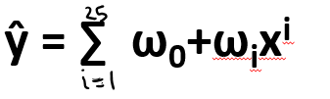
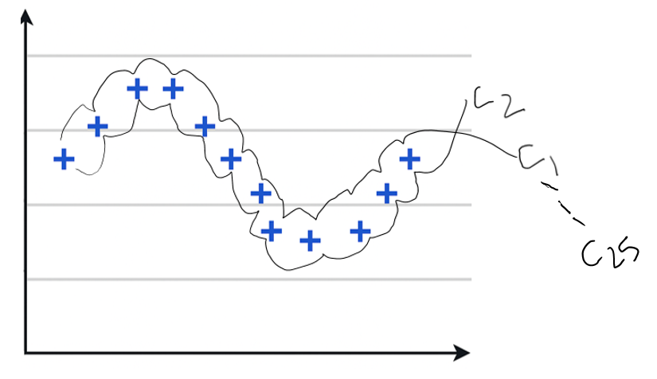
b) Complex model of high degree.

Slide 15
Note - In both the cases we are making an assumption about how y is related to x, we have no idea about the true relation.
Consider that the training data consist of 100 data points.
We sample 25 data points from this training data and train a simple and a complex model.
We repeat the process k times to train multiple such models.

Slide 16
Simple vs. Complex Models
Case 1: Simple models
Simple models trained on different samples of the same data distribution do not differ much from each other; however they are far away from the true sinusoidal curve.
Underfitting High Bias
Case 2: Complex models
On the other hand, complex models trained on different sets of same data distribution are very different from each other, however they are very close to the true data distribution.
Overfitting High Variance

Slide 17
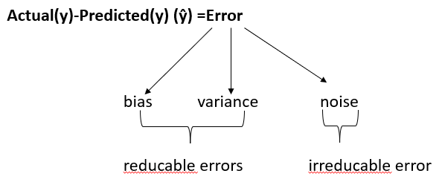
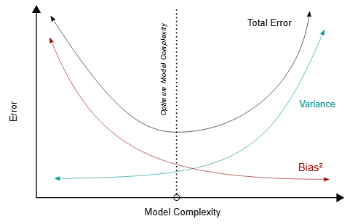

Slide 18
WAYS TO REDUCE HIGH BIAS:
Use a more complex model (degree of polynomial increase). (or no. of i/p features inc. )
Reduce regularization of the model.
Increase the size of training dataset (may/may not work).

Slide 19
WAYS TO REDUCE HIGH VARIANCE:
Use a less complex model.
Use Cross-validation techniques.
Feature selection (select most significant features, drop least significant features).
Regularization techniques:
Lasso
Ridge
Ensemble methods (make various models for the same task and then take a stable/pure output/decision by considering all o/p).
Early stopping (can be used here, in neural networks, etc.).

Slide 20
CV and Bias-Variance
Low k (e.g., 2-fold): High bias, low variance → fast but less accurate.
High k (e.g., 10-fold): Low bias, high variance → more accurate but costly.
Common choice: k = 5 or 10.

Slide 21
Why Use CV for Model Selection?
Estimates Generalization Performance:
CV provides a more reliable estimate of how well a model will perform on new, unseen data, rather than just on the training data.
Prevents Overfitting:
By using different parts of the data for training and testing in multiple iterations, CV helps to identify and prevent overfitting, where a model becomes too specialized to the training data and performs poorly on new data.
Provides a Robust Evaluation:
Averaging the scores from multiple folds reduces the impact of any single data split, leading to a more stable and trustworthy assessment of the model's capabilities.

Slide 22
Summary
Generalization measures performance on unseen data.
Cross-validation gives stable performance estimates.
k-fold CV balances training & validation.
Bias-Variance trade-off defines model complexity.
Use CV scores for reliable model selection.

